Slide 1
HYPERMEDIA
ASP.NET WEB API
Bringing Knowledge to your APIs

Slide 2

Bringing Hypermedia to ASP.NET Web API
Chris Woodruff
Solution Architect,
Rocket Homes
Level: Intermediate

Slide 3
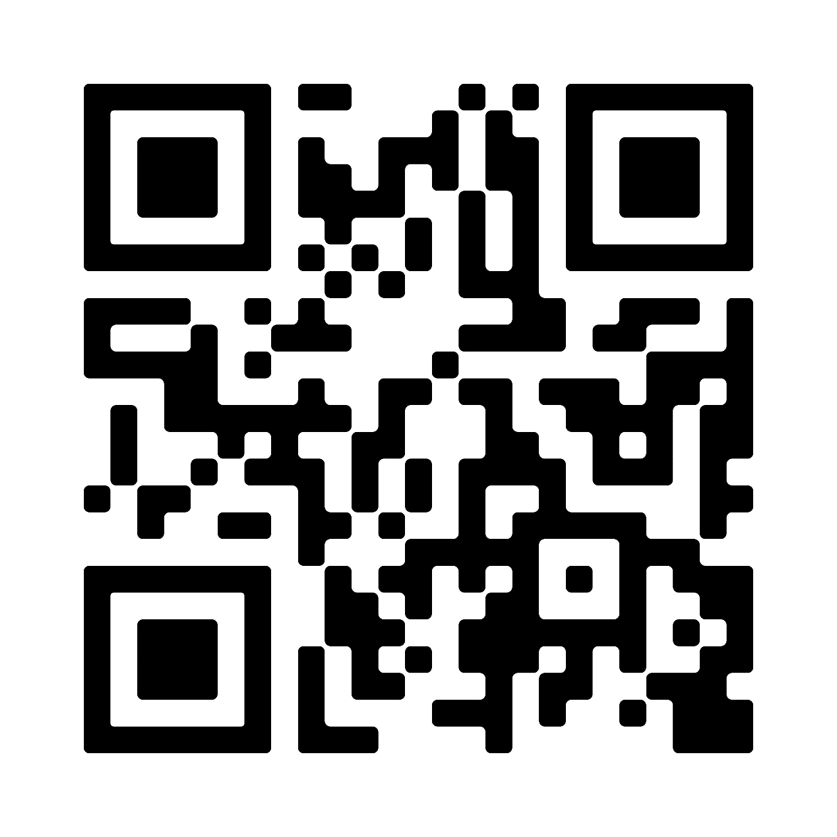
Session Survey
Your feedback is very important to us
Please take a moment to complete the session survey found in the mobile app
Use the QR code or search for “Converge360 Events” in your app store
Find this session on the Agenda tab
Click “Session Evaluation”
Thank you!

Slide 4
01
02
03
METADATA
DEEP-DIVE
CODE EXAMPLES
Why do we need Hypermedia in ASP.NET Web API?
Let’s look at REST and why Hypermedia is so important
How do we implement Hypermedia in Web API?

Slide 5
Chris Woodruff
This could be the part of the presentation where you can introduce yourself, write your email...

Slide 6
“This is a quote, words full of wisdom that someone important said and can make the reader get inspired.”
—Someone Famous

Slide 7
METADATA
01
Why do we need Hypermedia in ASP.NET Web API?

Slide 8
THE SLIDE TITLE GOES HERE!
Do you know what helps to make your point clear? Lists like this: one
They’re simple
You can organize your ideas clearly
You’ll never forget to buy milk!
And the most important thing: the audience won’t miss the point of your presentation

Slide 9
DEEP-DIVE
02
Let’s look at REST and why Hypermedia is so important

Slide 10
THE SLIDE TITLE GOES HERE!
Do you know what helps to make your point clear? Lists like this: one
They’re simple
You can organize your ideas clearly
You’ll never forget to buy milk!
And the most important thing: the audience won’t miss the point of your presentation

Slide 11
CODE EXAMPLES
03
How do we implement Hypermedia in Web API?

Slide 12
THE SLIDE TITLE GOES HERE!
Do you know what helps to make your point clear? Lists like this: one
They’re simple
You can organize your ideas clearly
You’ll never forget to buy milk!
And the most important thing: the audience won’t miss the point of your presentation

Slide 13

Code
How do we implement Hypermedia in Web API?

Slide 14

AWESOME WORDS
Because key words are great for catching your audience’s attention

Slide 15
A GOOD WAY TO END THE PRESENTATION
Mercury is the closest planet to the Sun and the smallest one in the Solar System—it’s only a bit larger than the Moon

Slide 16
THANKS!
Do you have any questions?
cwoodruff@live.com
616 724 6885
@cwoodruff

Slide 17
Session Survey
Your feedback is very important to us
Please take a moment to complete the session survey found in the mobile app
Use the QR code or search for “Converge360 Events” in your app store
Find this session on the Agenda tab
Click “Session Evaluation”
Thank you!

